Slide 1
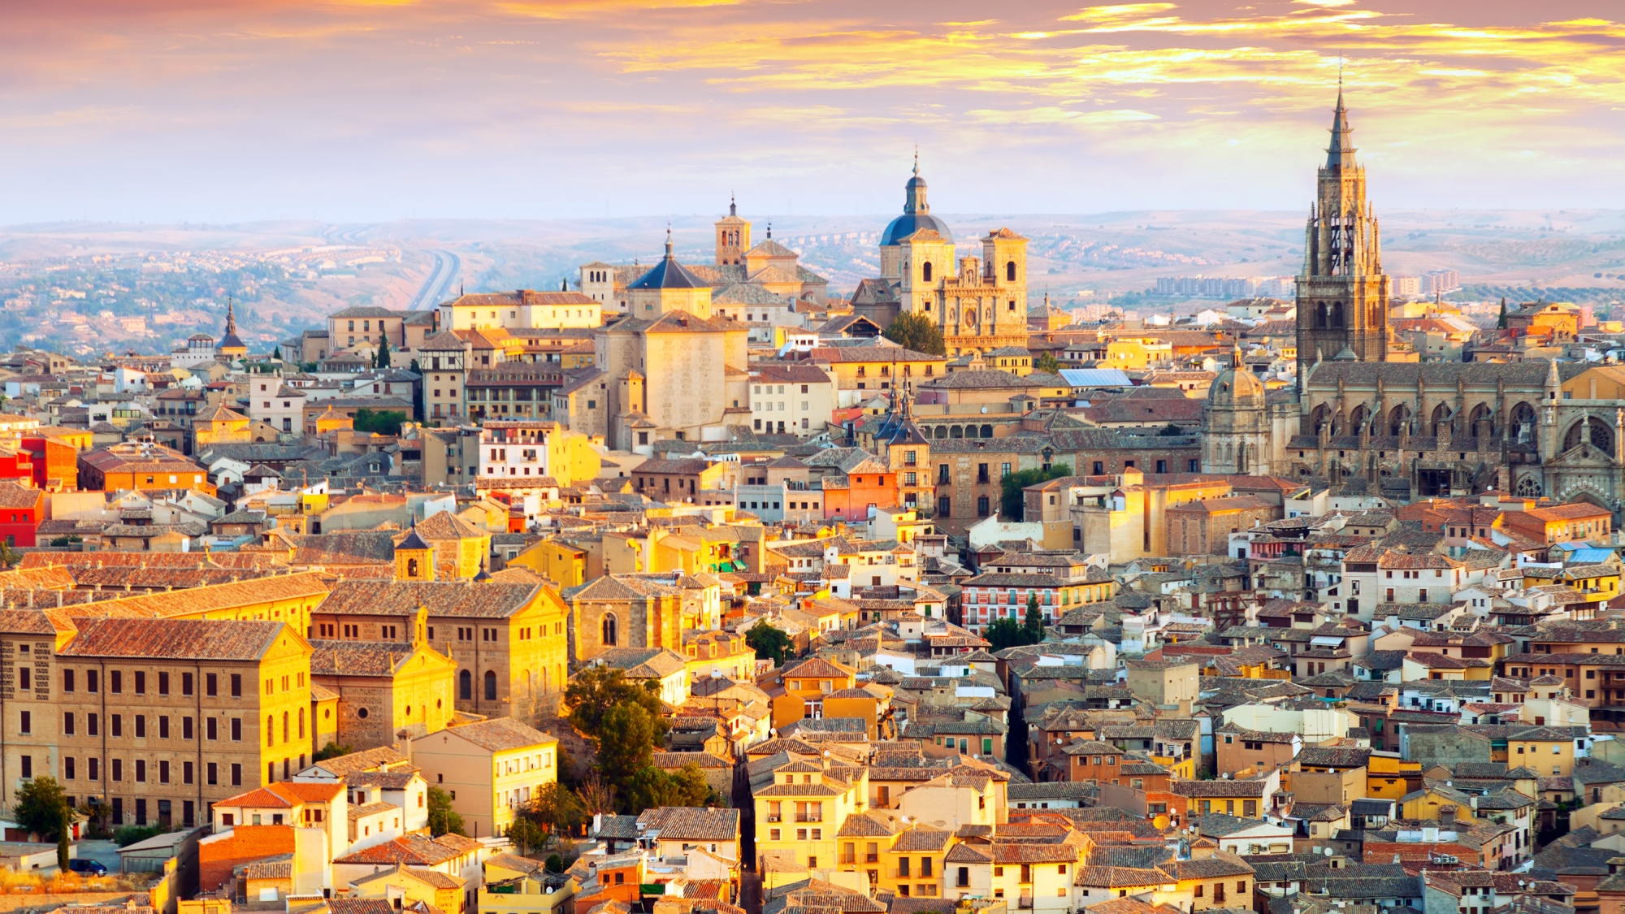
Portugal Hotel Bookings Machine Learning Project
By: Mohamed Ali

Slide 2

Introduction
Victoria B.C
Bachelors Degree in Accounting
Exciting Data Science Journey!
2

Slide 3
Problem Statement
For this project I will be working with a real hotel booking dataset.
The main goal for a hotel is to maximize revenue generated from bookings, by maintaining a high level of occupancy. However, cancellations made by customers can effect this objective and lead to lost revenue due to unsold rooms. Addressing the issue of cancellations becomes crucial in strategic decision making. By effectively managing and minimizing cancellations, hotels can reduce the negative impact on occupancy rates and maximize their revenue potential.
3

Slide 4




Project Goals
Identify strategies to maximize hotel revenue by understanding booking patterns, cancellations, and factors affecting occupancy rates and average daily rates (ADR).
Train a time-series model to forecast revenue and cancellations.
Build a classification model that predicts whether a booking will be cancelled
Utilize acquired machine learning and data analytics tools and techniques to address real-world business challenges.
4

Slide 5
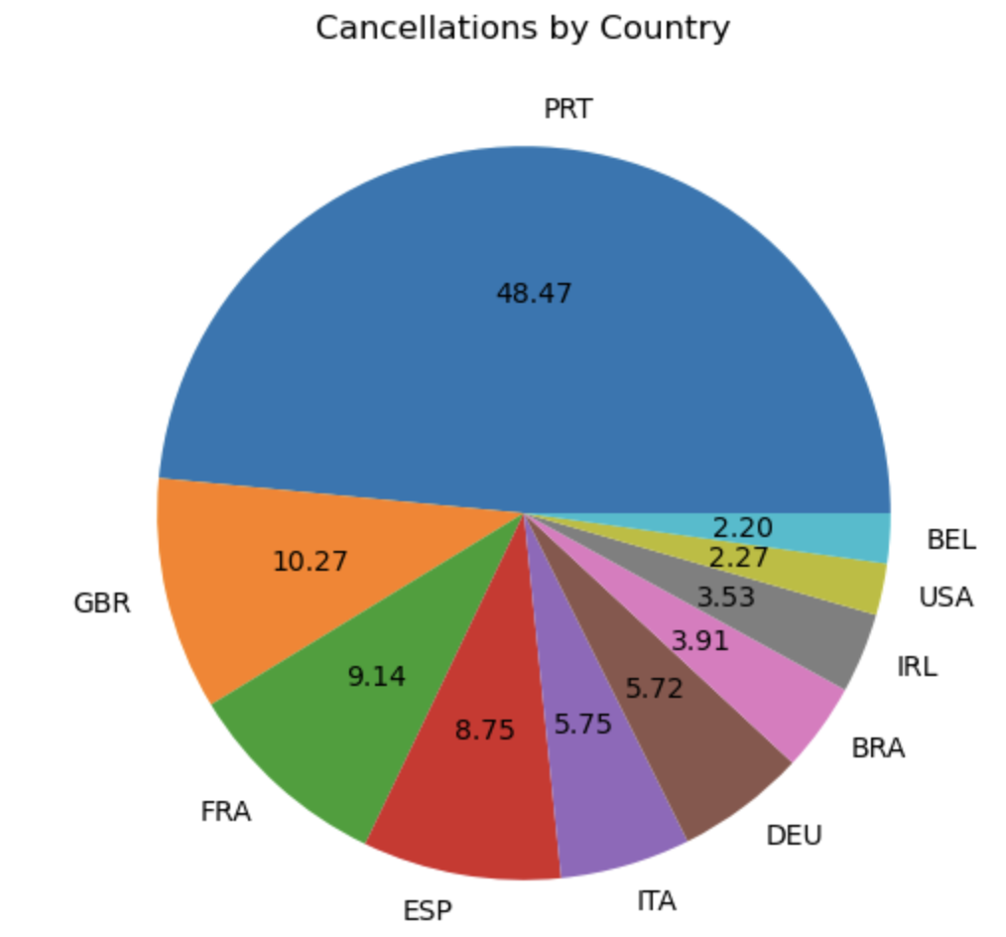
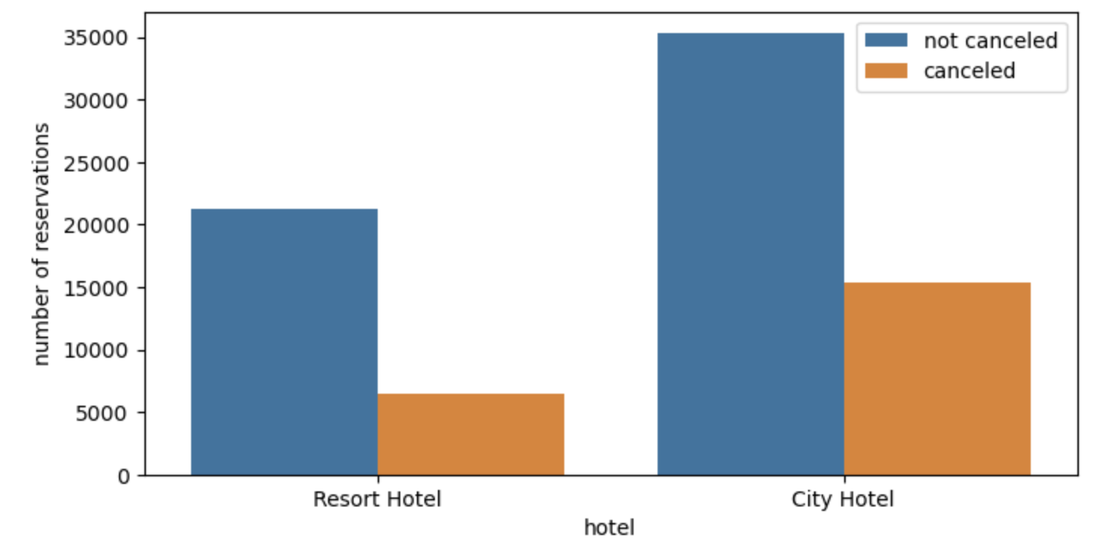
Exploratory Data Analysis
Highlights from the dataset:
Bookings are from two hotels in Portugal: City Hotel & Resort Hotel
Contains 120,000 data points: 2015 -> 2017
Data is imbalanced: 73% confirmed bookings & 27% cancelled
Majority of cancellations are from Portugal, UK, France, and Spain
5

Slide 6

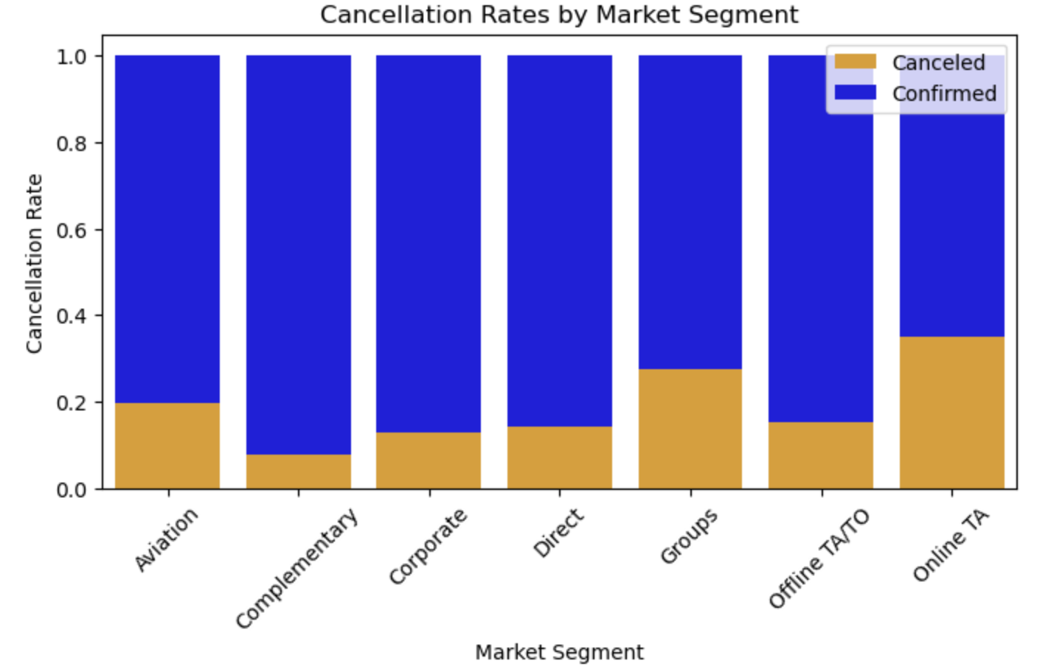
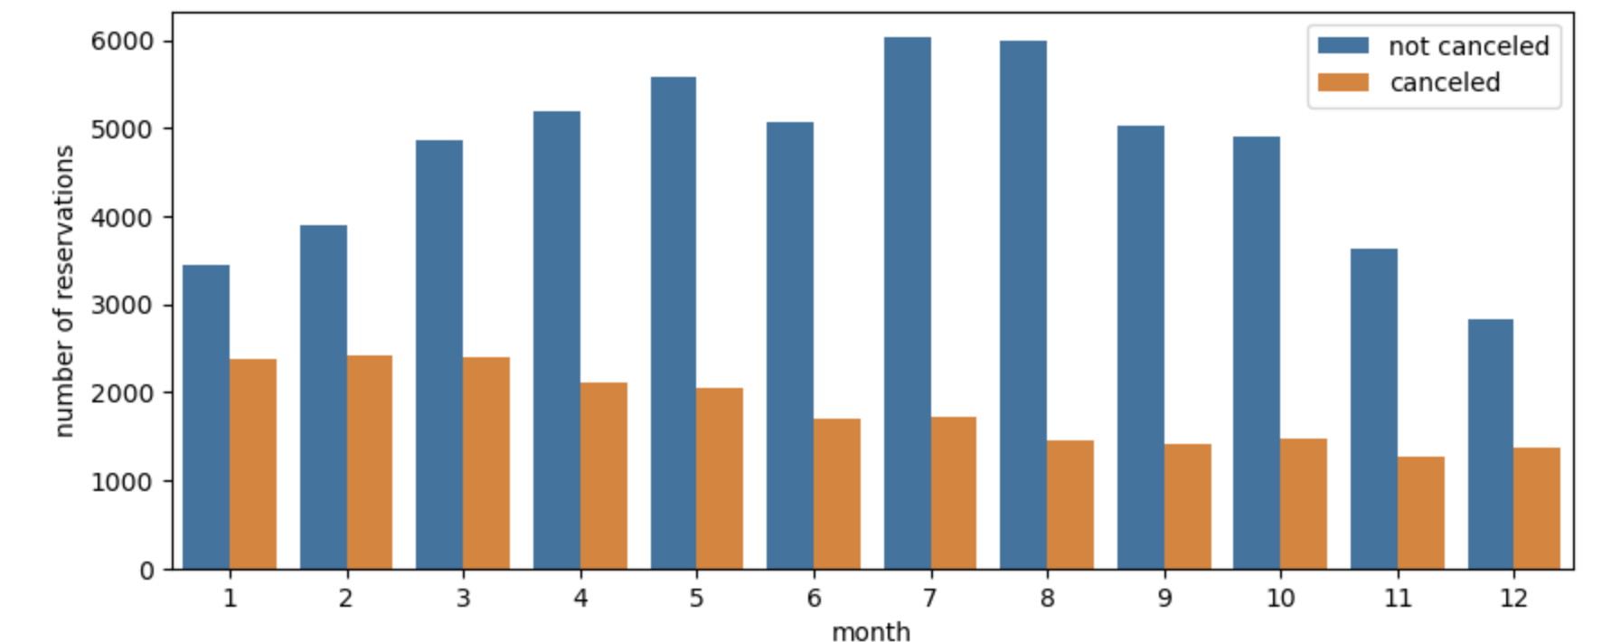
Cancellation by Month & Market Segment
We can see that online & group bookings have a higher chance of cancellation
Winter months have a higher ratio of cancellations to bookings
6

Slide 7
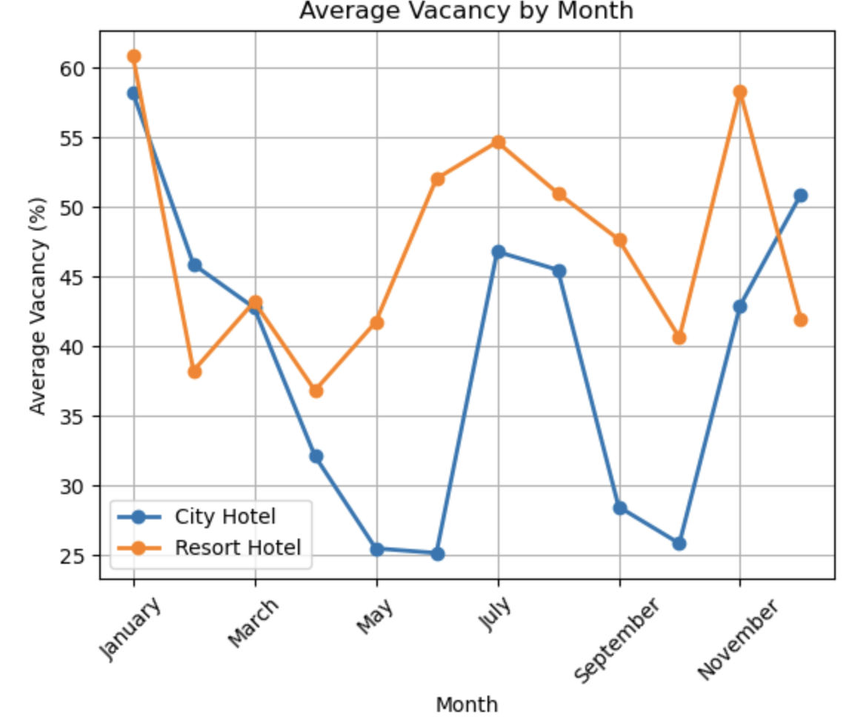
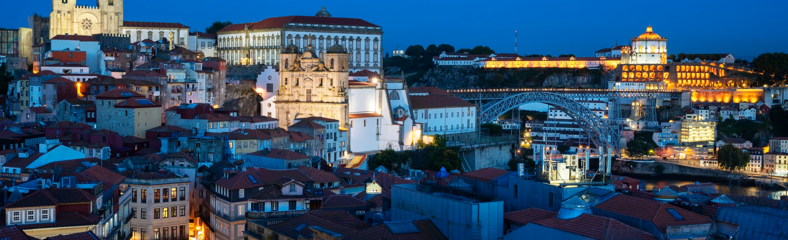
Hotel performance
Vacancy data created by taking the day with the most bookings and using it as a benchmark for 100% occupancy.
We can see that the average vacancy for the winter months is higher which is an opportunity to increase revenue
The average vacancy for city hotel and resort hotel is 37.33%, and 46.95%
7

Slide 8
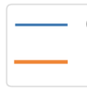
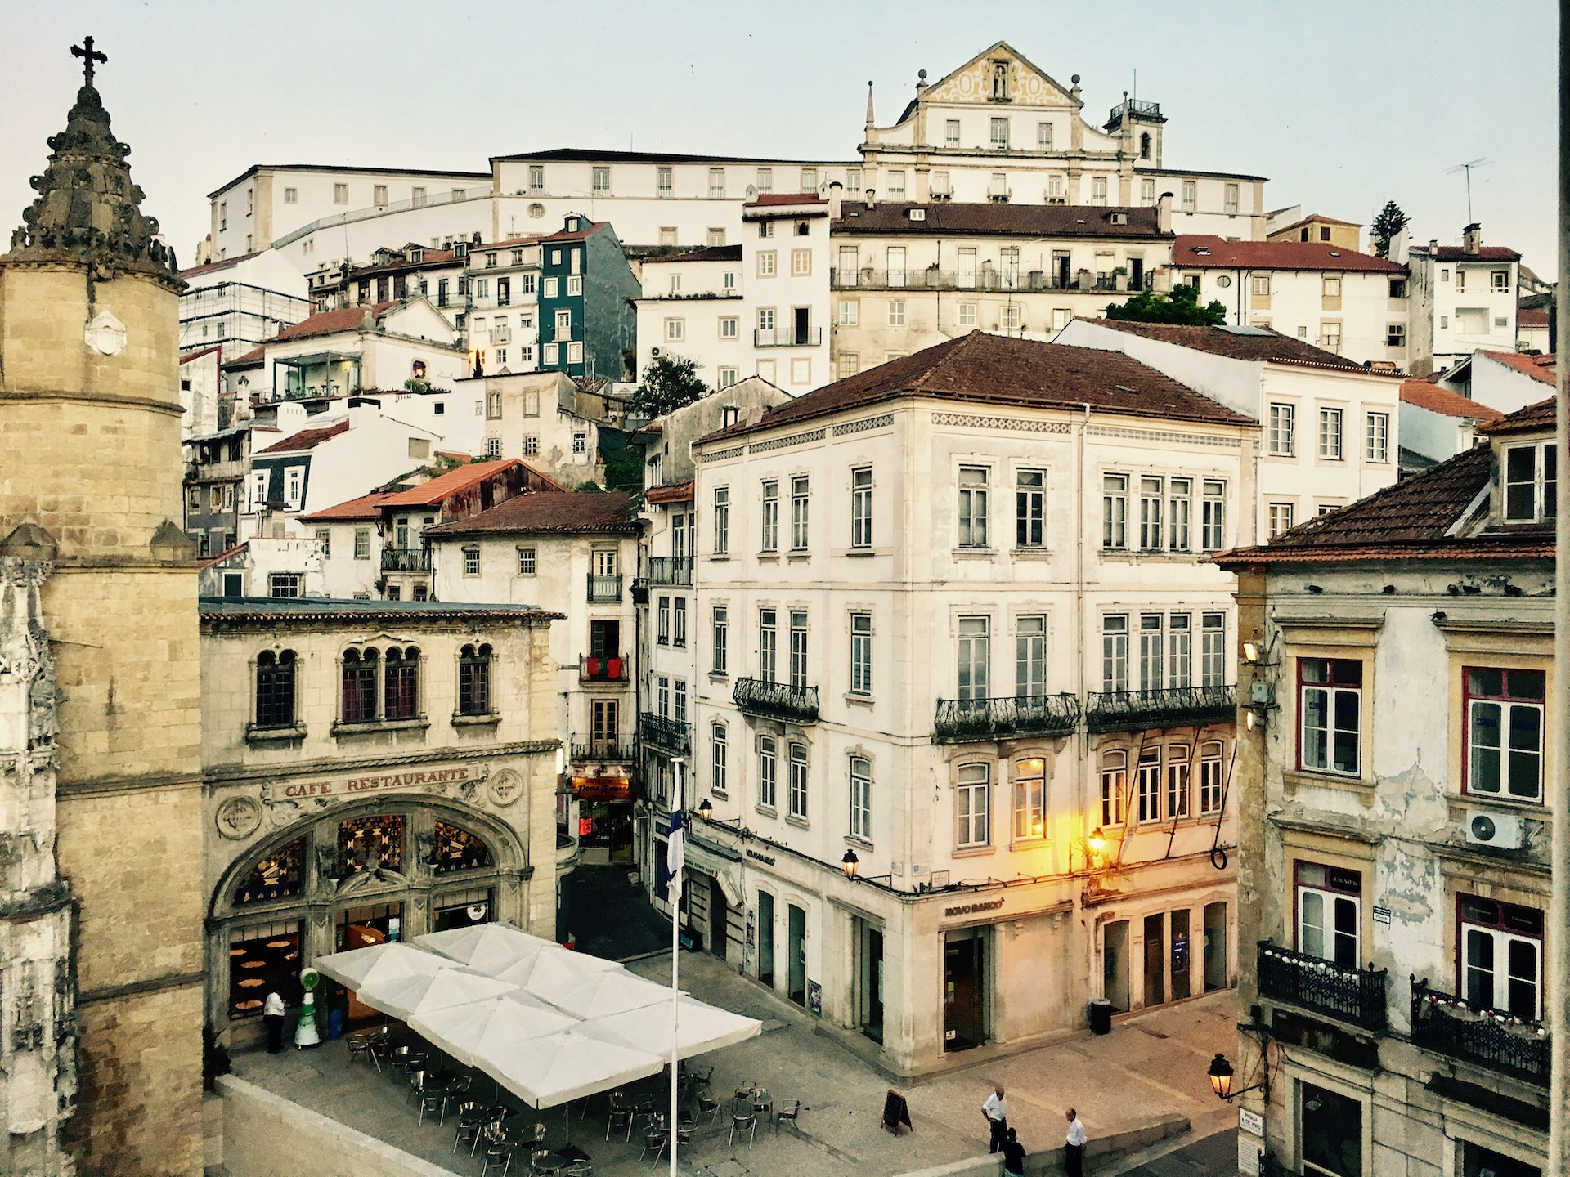
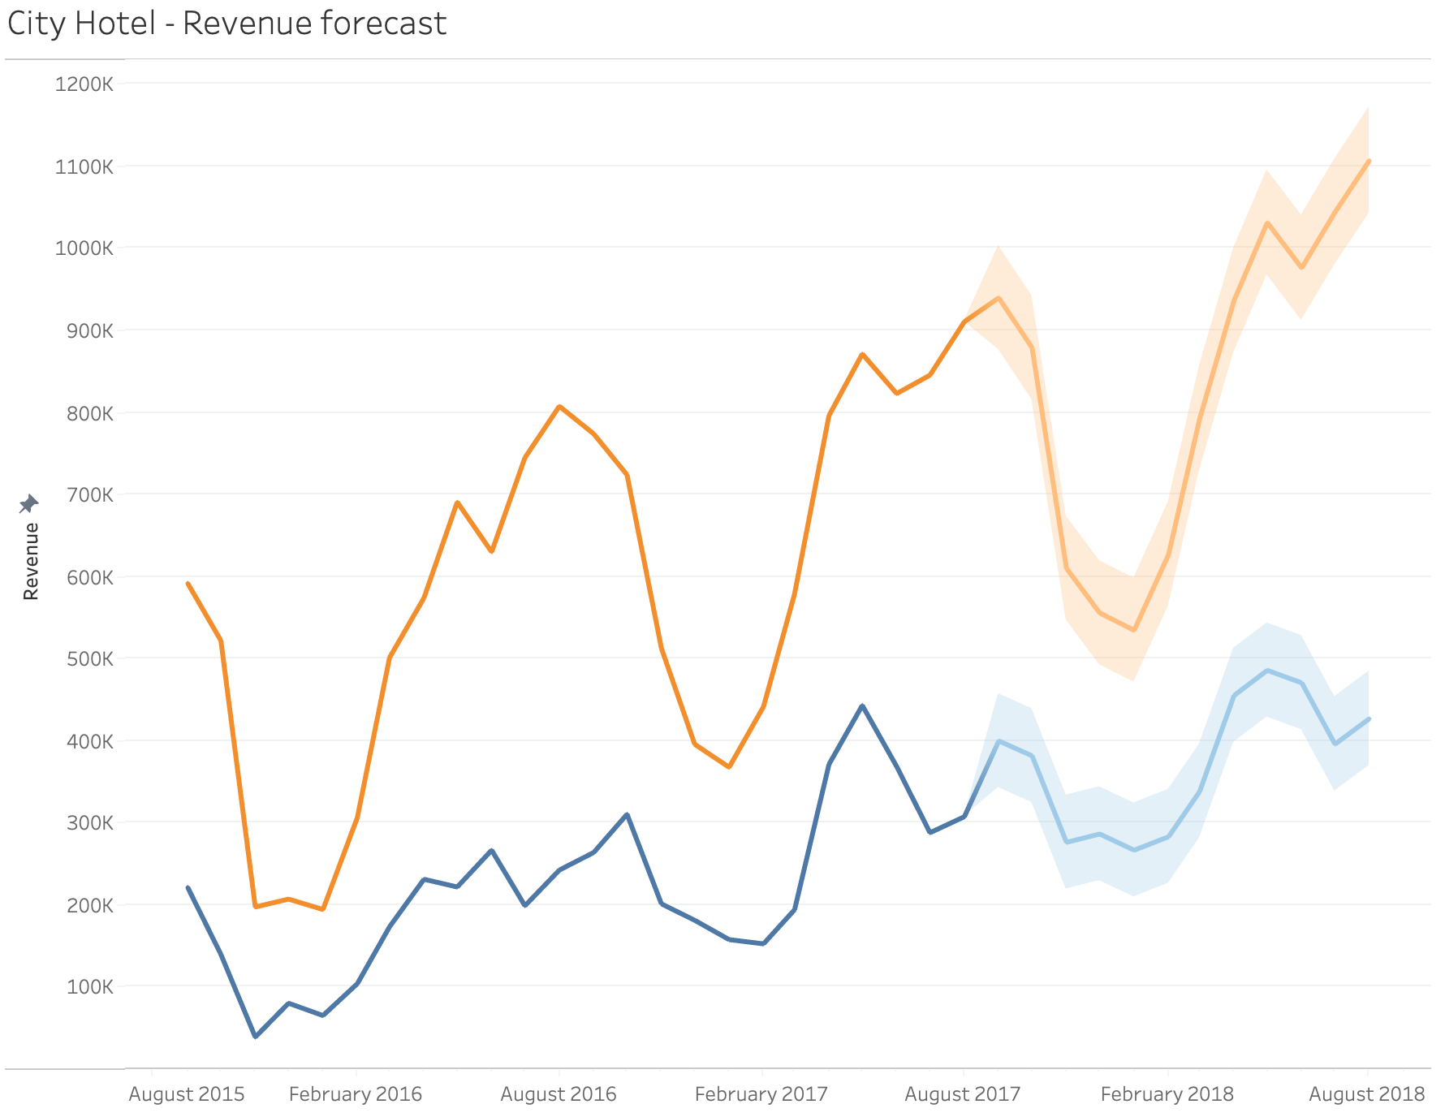
Revenue Forecast / Lost revenue
Revenue
Revenue lost to cancellations
Average Monthly Revenue Forecast
Created revenue data by using the adjusted room rate, length of stay, and distributing it evenly across dates.
This will be useful for a benchmark on the performance of strategic decisions.
The forecasted revenue averages $750,000 a month without any changes.
The forecasted revenue lost to cancellations is about $325,000.
8

Slide 9
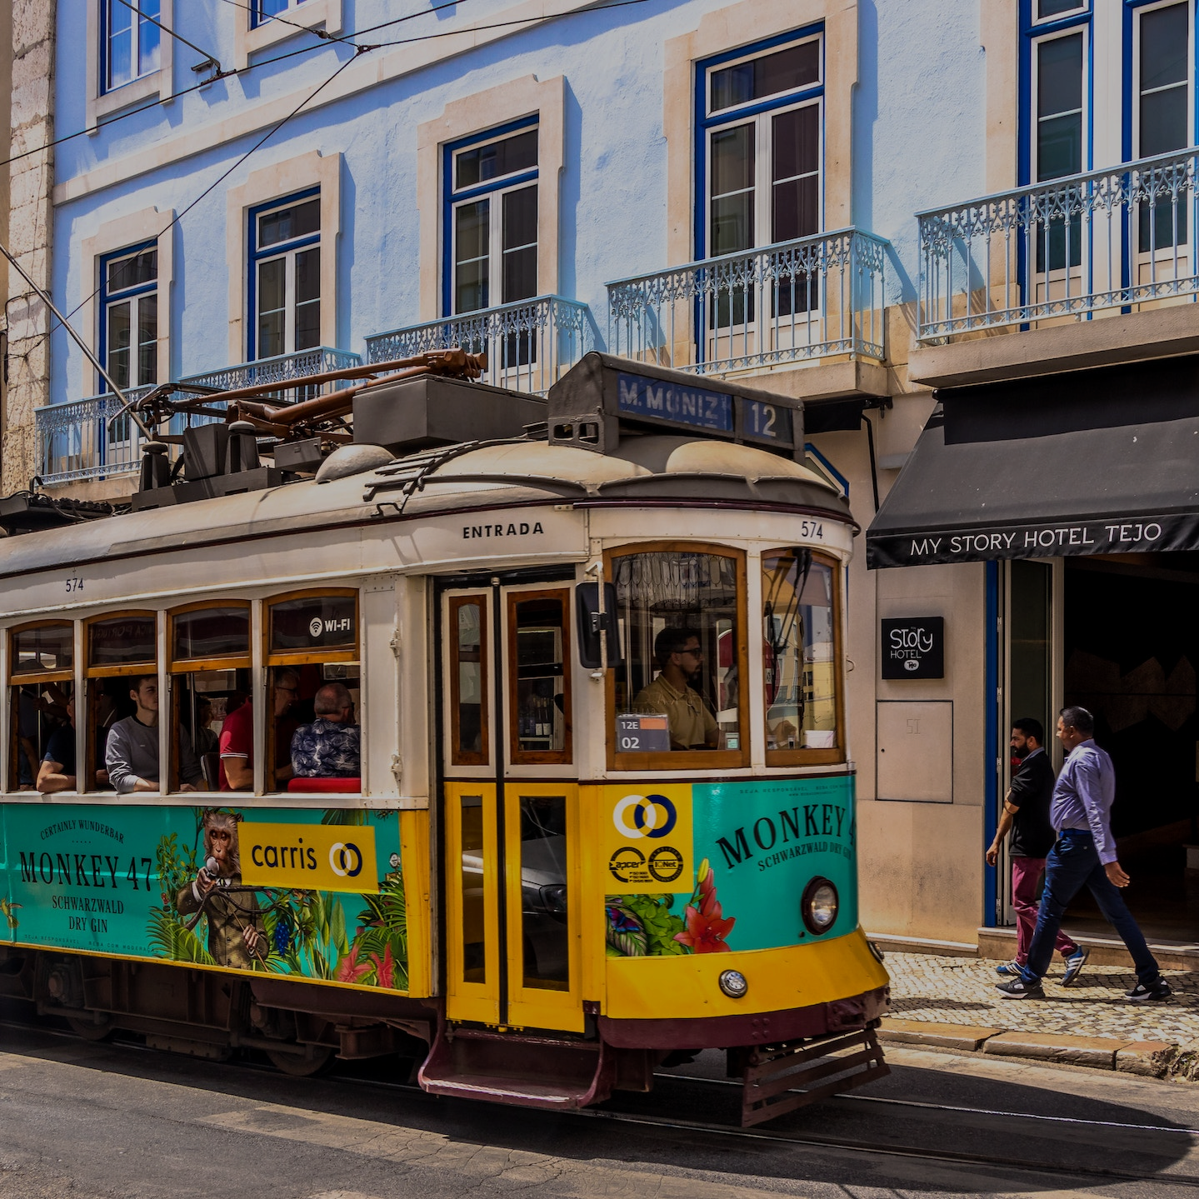



Build a classification model that accurately predicts bookings that will be cancelled. For the cancellation predictions offer a discount on stay if non-refundable booking deposit is made.
During high vacancy months increase the selling of Opaque bookings which involve the sale of hotel rooms at discounted rates, where the specific hotel name is not revealed to the customer until after the booking is completed. (Hotwire)
Strategic Recommendations
Advance Purchase Offers: Offer discounted rates or special packages for guests who book in advance and prepay for their stay. This encourages guests to commit to their reservation and reduces the likelihood of cancellations.
9

Slide 10
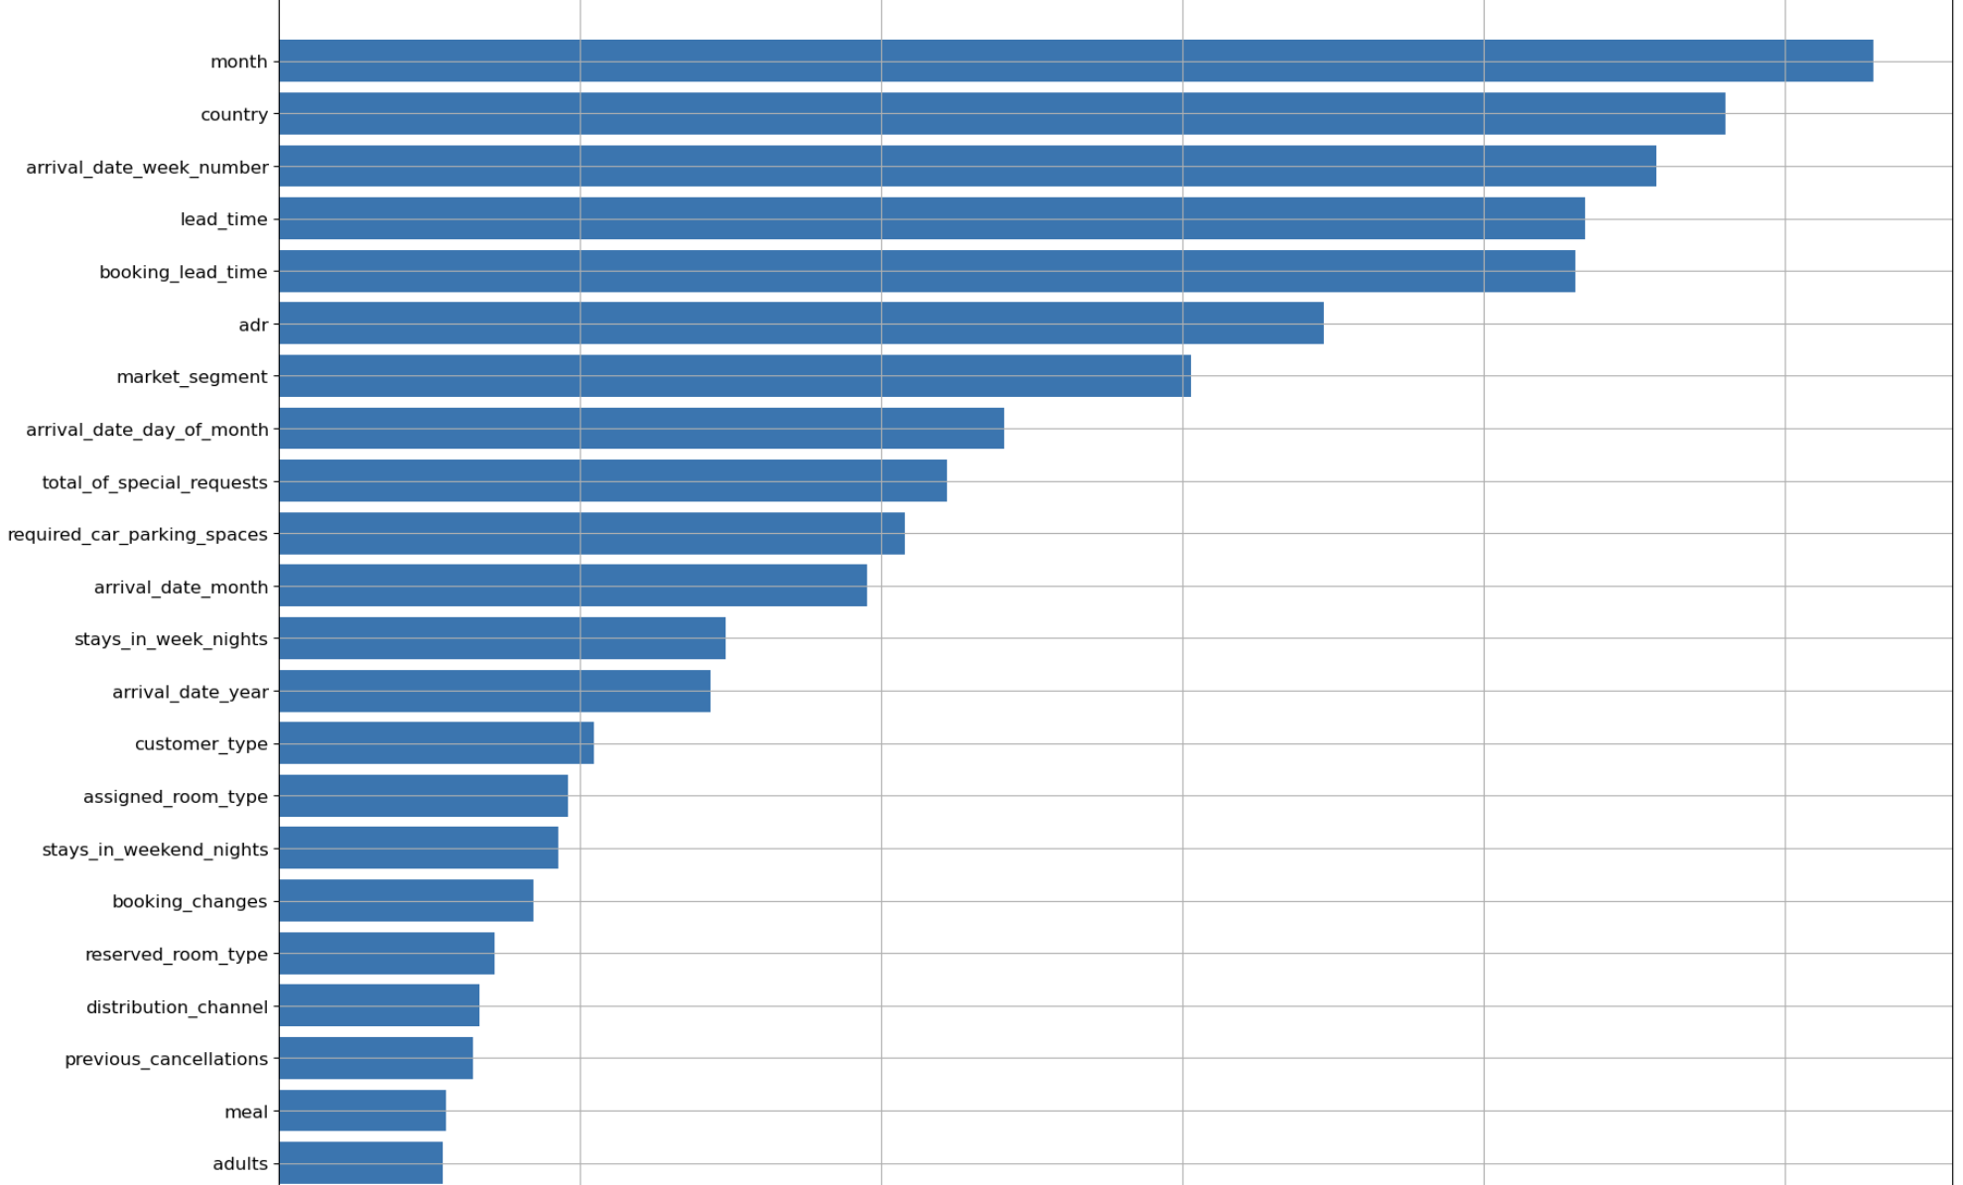
Classification Models– predicting cancellations
Machine learning models used:
Decision Tree Classifier
Random Forest Classifier
Gaussian Naïve Bayes
Logistic Regression
Important features: Booking lead time, country, arrival date, and occupancy.
10

Slide 11
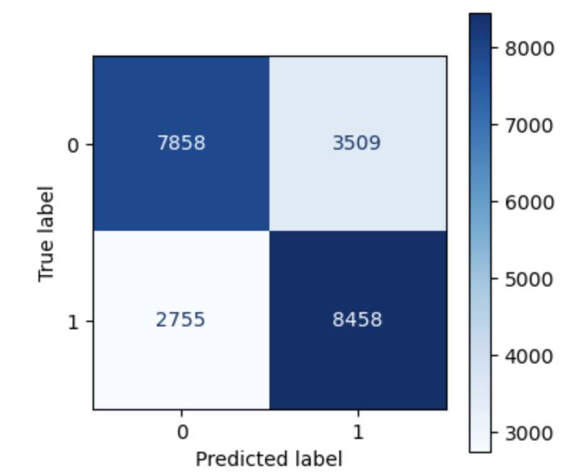
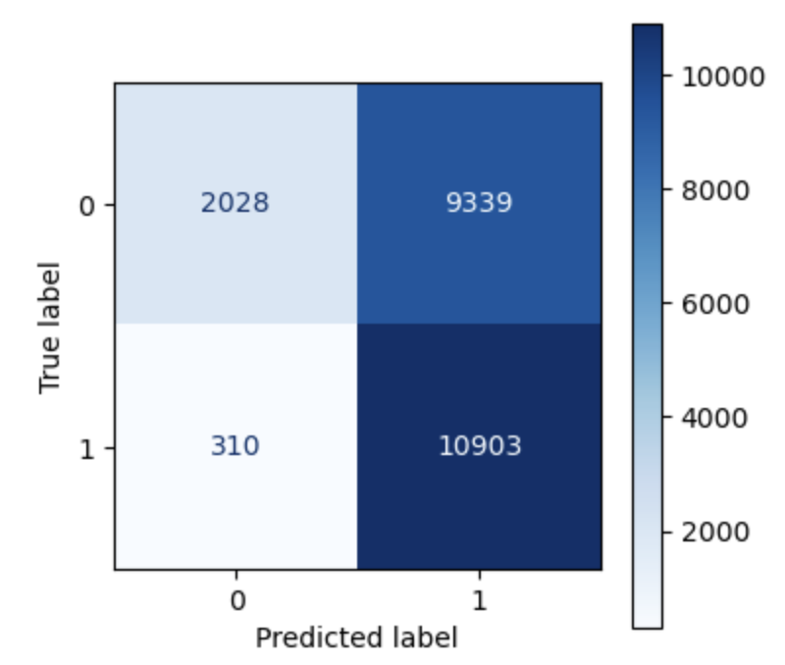
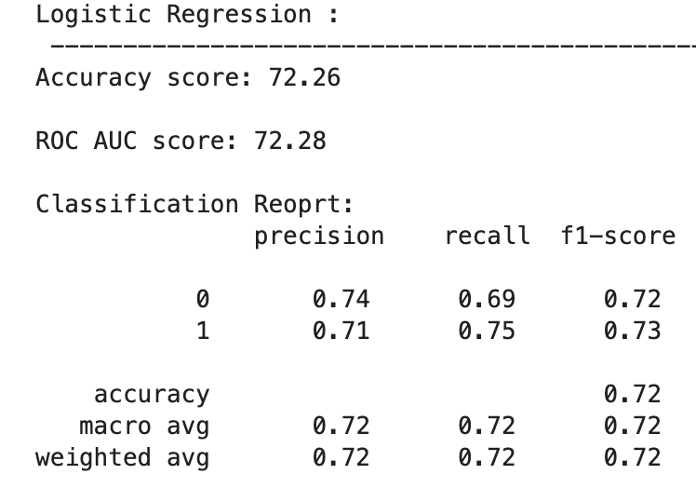
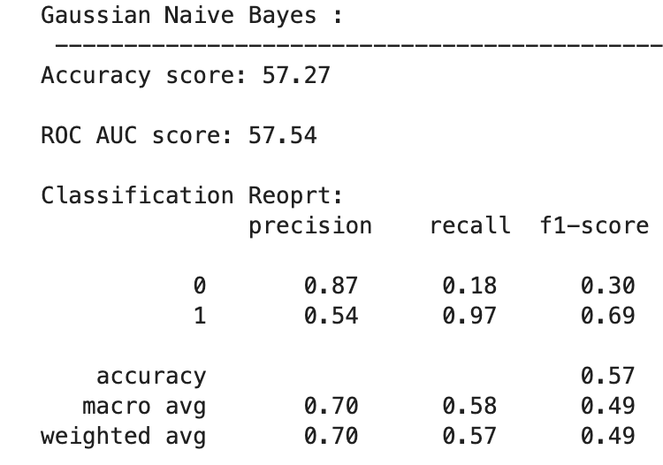
Model Performance
Logistic Regression:
Gaussian Naïve Bayes
These two models were not performing well as the models were predicting a high number of false negatives and false positives.
11

Slide 12
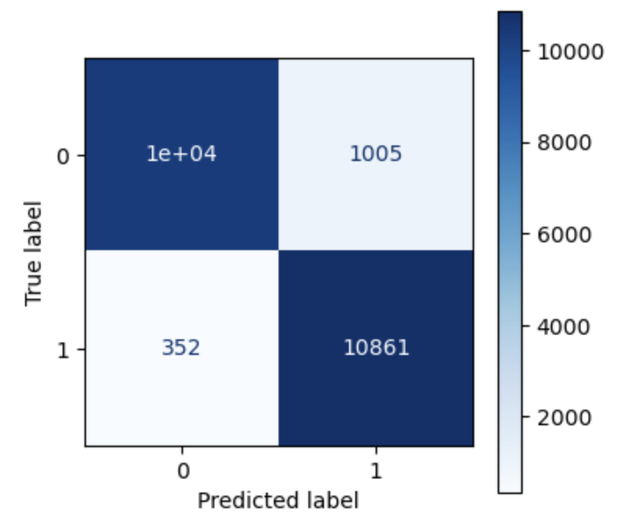
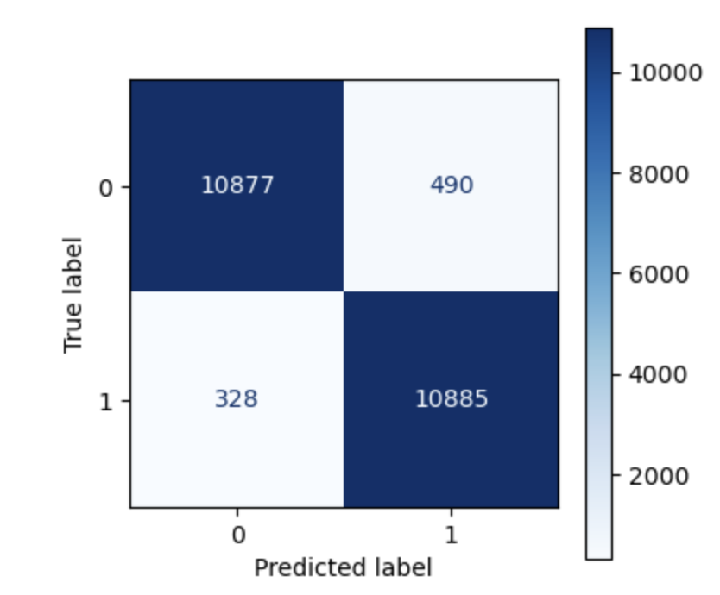
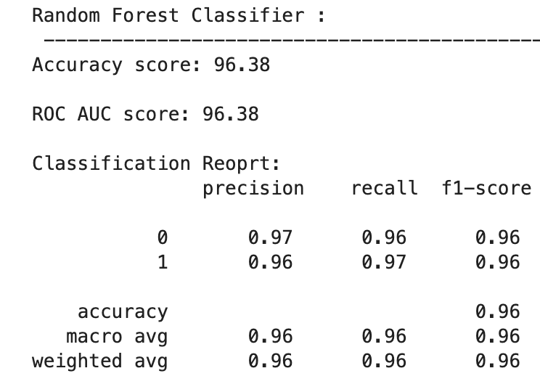
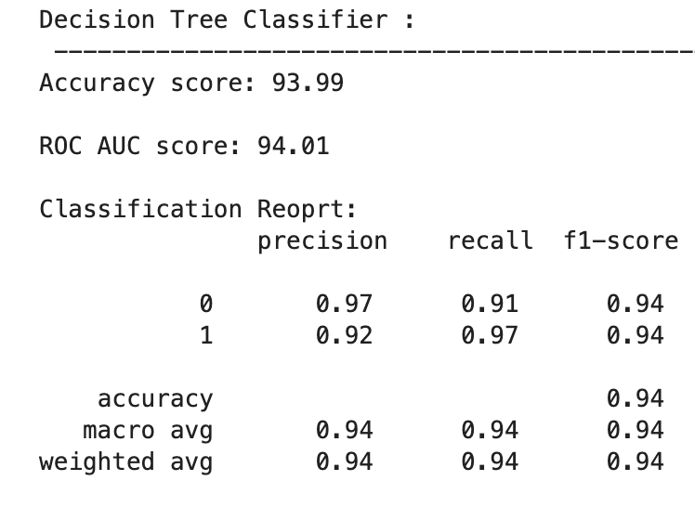
Model Performance
Decision Tree Classifier:
Random Forest Classifier:
My Decision tree classifier model & Random Forest Classifier Model were performing very well in there predictions. However, the models were overfitting.
By Hyperparameter tuning my Random Forest Classifier with Grid Search I was able to achieve 83% accuracy on testing set.
12

Slide 13
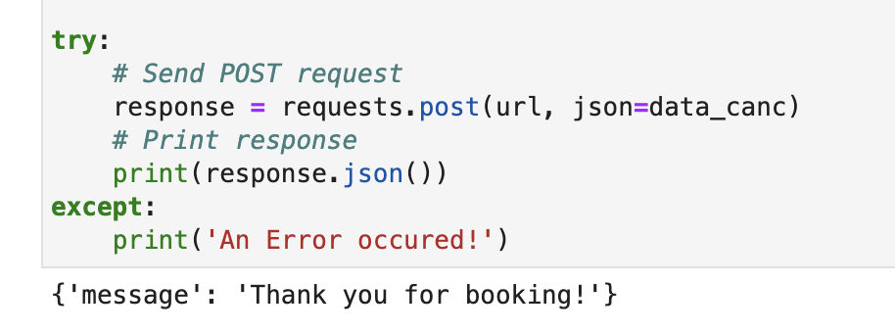
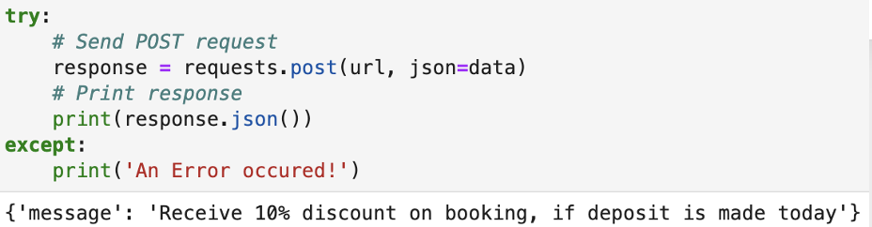
Model Implementation Plan
Deploy the model in bookings
Model Prediction
API built for requests
Model Predicts Cancellation
Offer Discount for Non-Refundable Deposit
Not Cancelled
If Non-refundable deposit not made. Consider overbooking
Thank you for booking!
Evaluate Performance
13

Slide 14

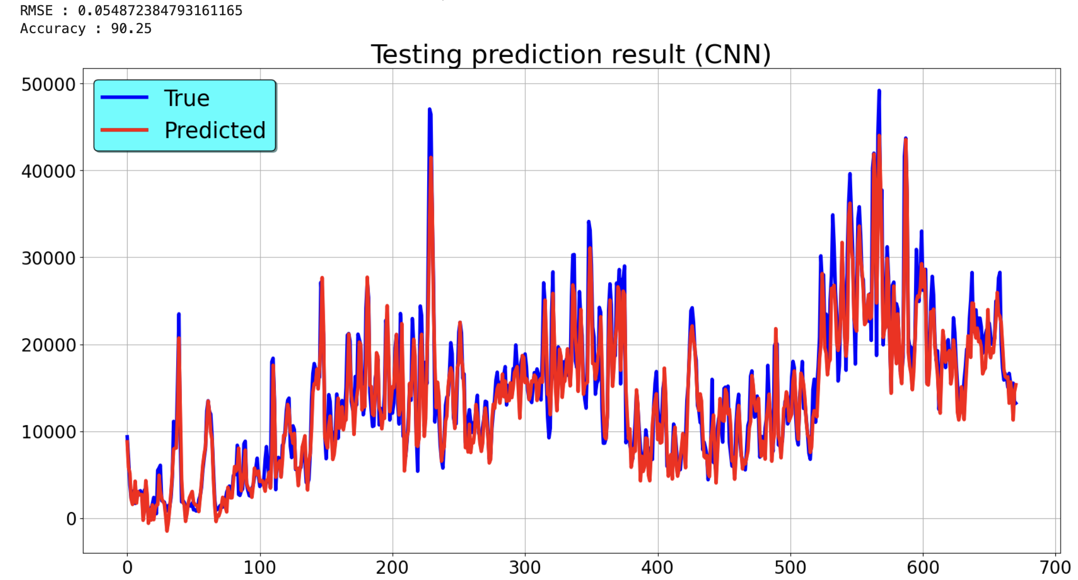

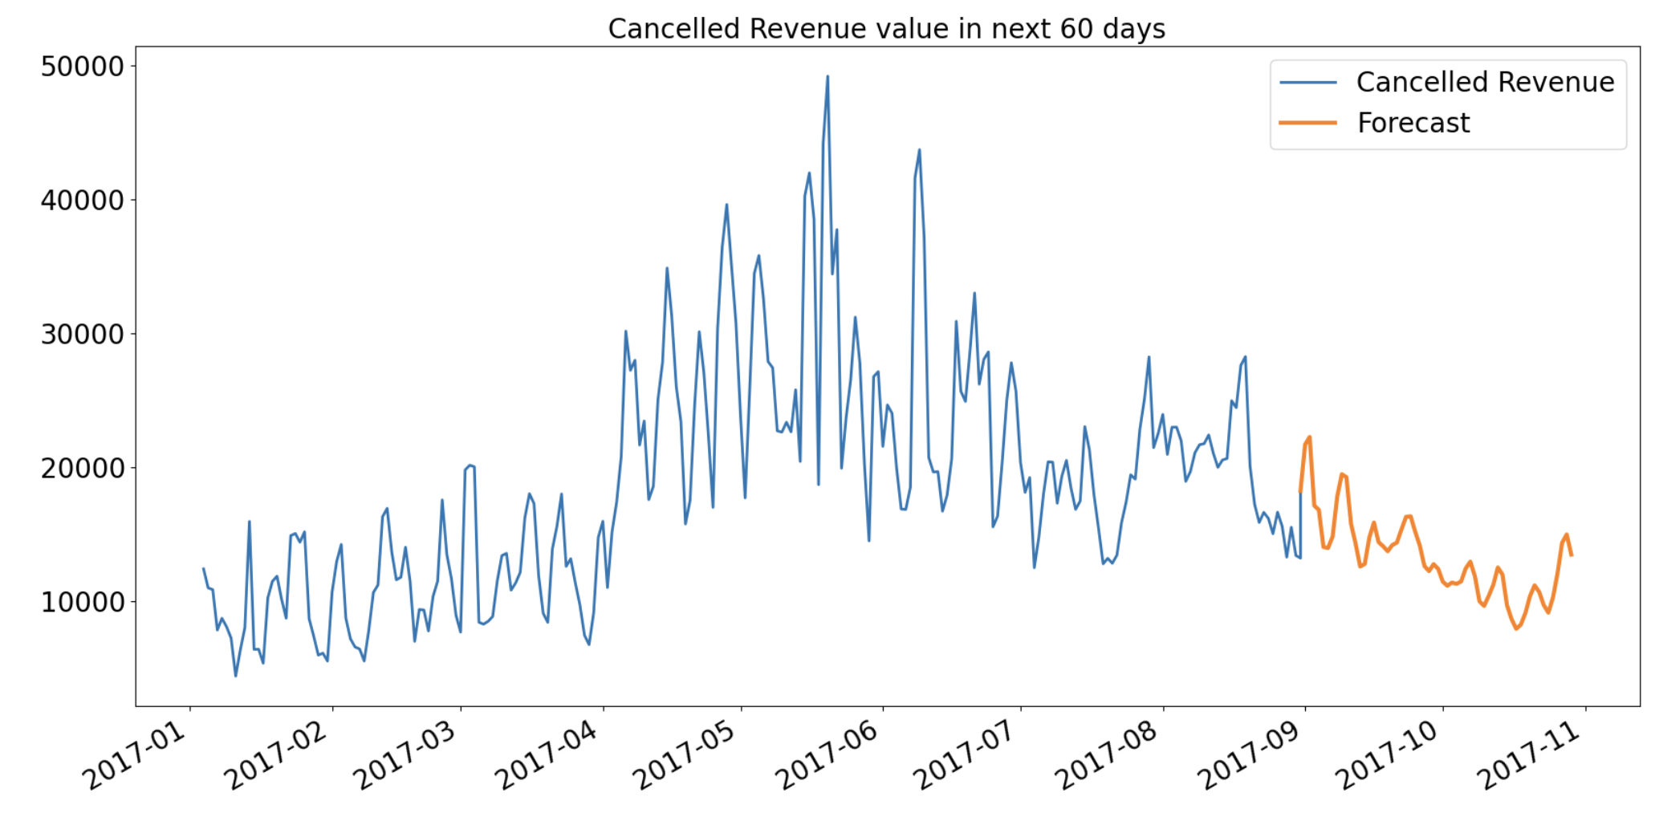

Convolution Neural Network
Train a deep learning time series model with 90% accuracy on historic data for revenue lost to cancellations.
Use model to forecast cancellations to evaluate the performance of strategic decisions. If strategic decisions are working then we should have less cancellation revenue than forecasted.
14
Notes:
Business Model
Save large scale of money for developer & charge % of a transaction.
Enable growth/sales for supplier. Charge them a Monthly subscription (MRR = monthly recurring revenues) for using the various tools of the platform.

Slide 15
Next Steps:
Create a dashboard for the API where inputs can be put in and a response will be generated.
Deploy the API on AWS
Create more forecasts
15

Slide 16
ThankYou
16

